Slide 1
Machine learning
~Abhishek Kumar

Slide 2
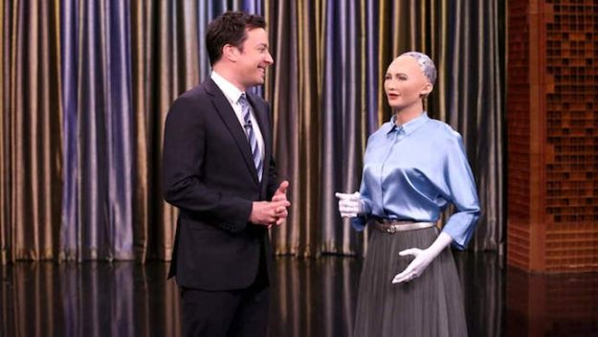
What is Machine learning?

Slide 3
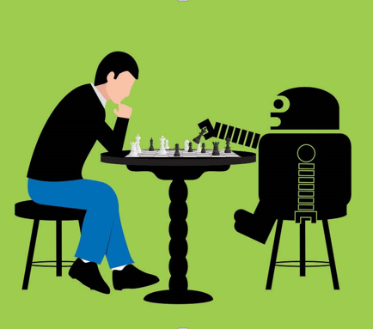
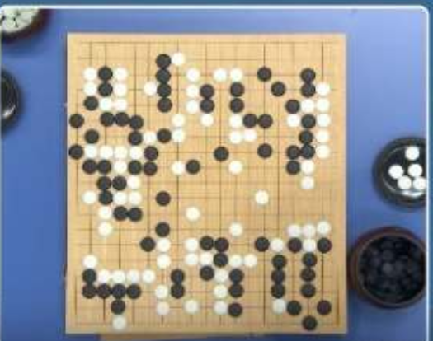
Go player
Go
LOL!!!!
That was easy
DeepMind’s
AlphaGo
KE JIE

Slide 4
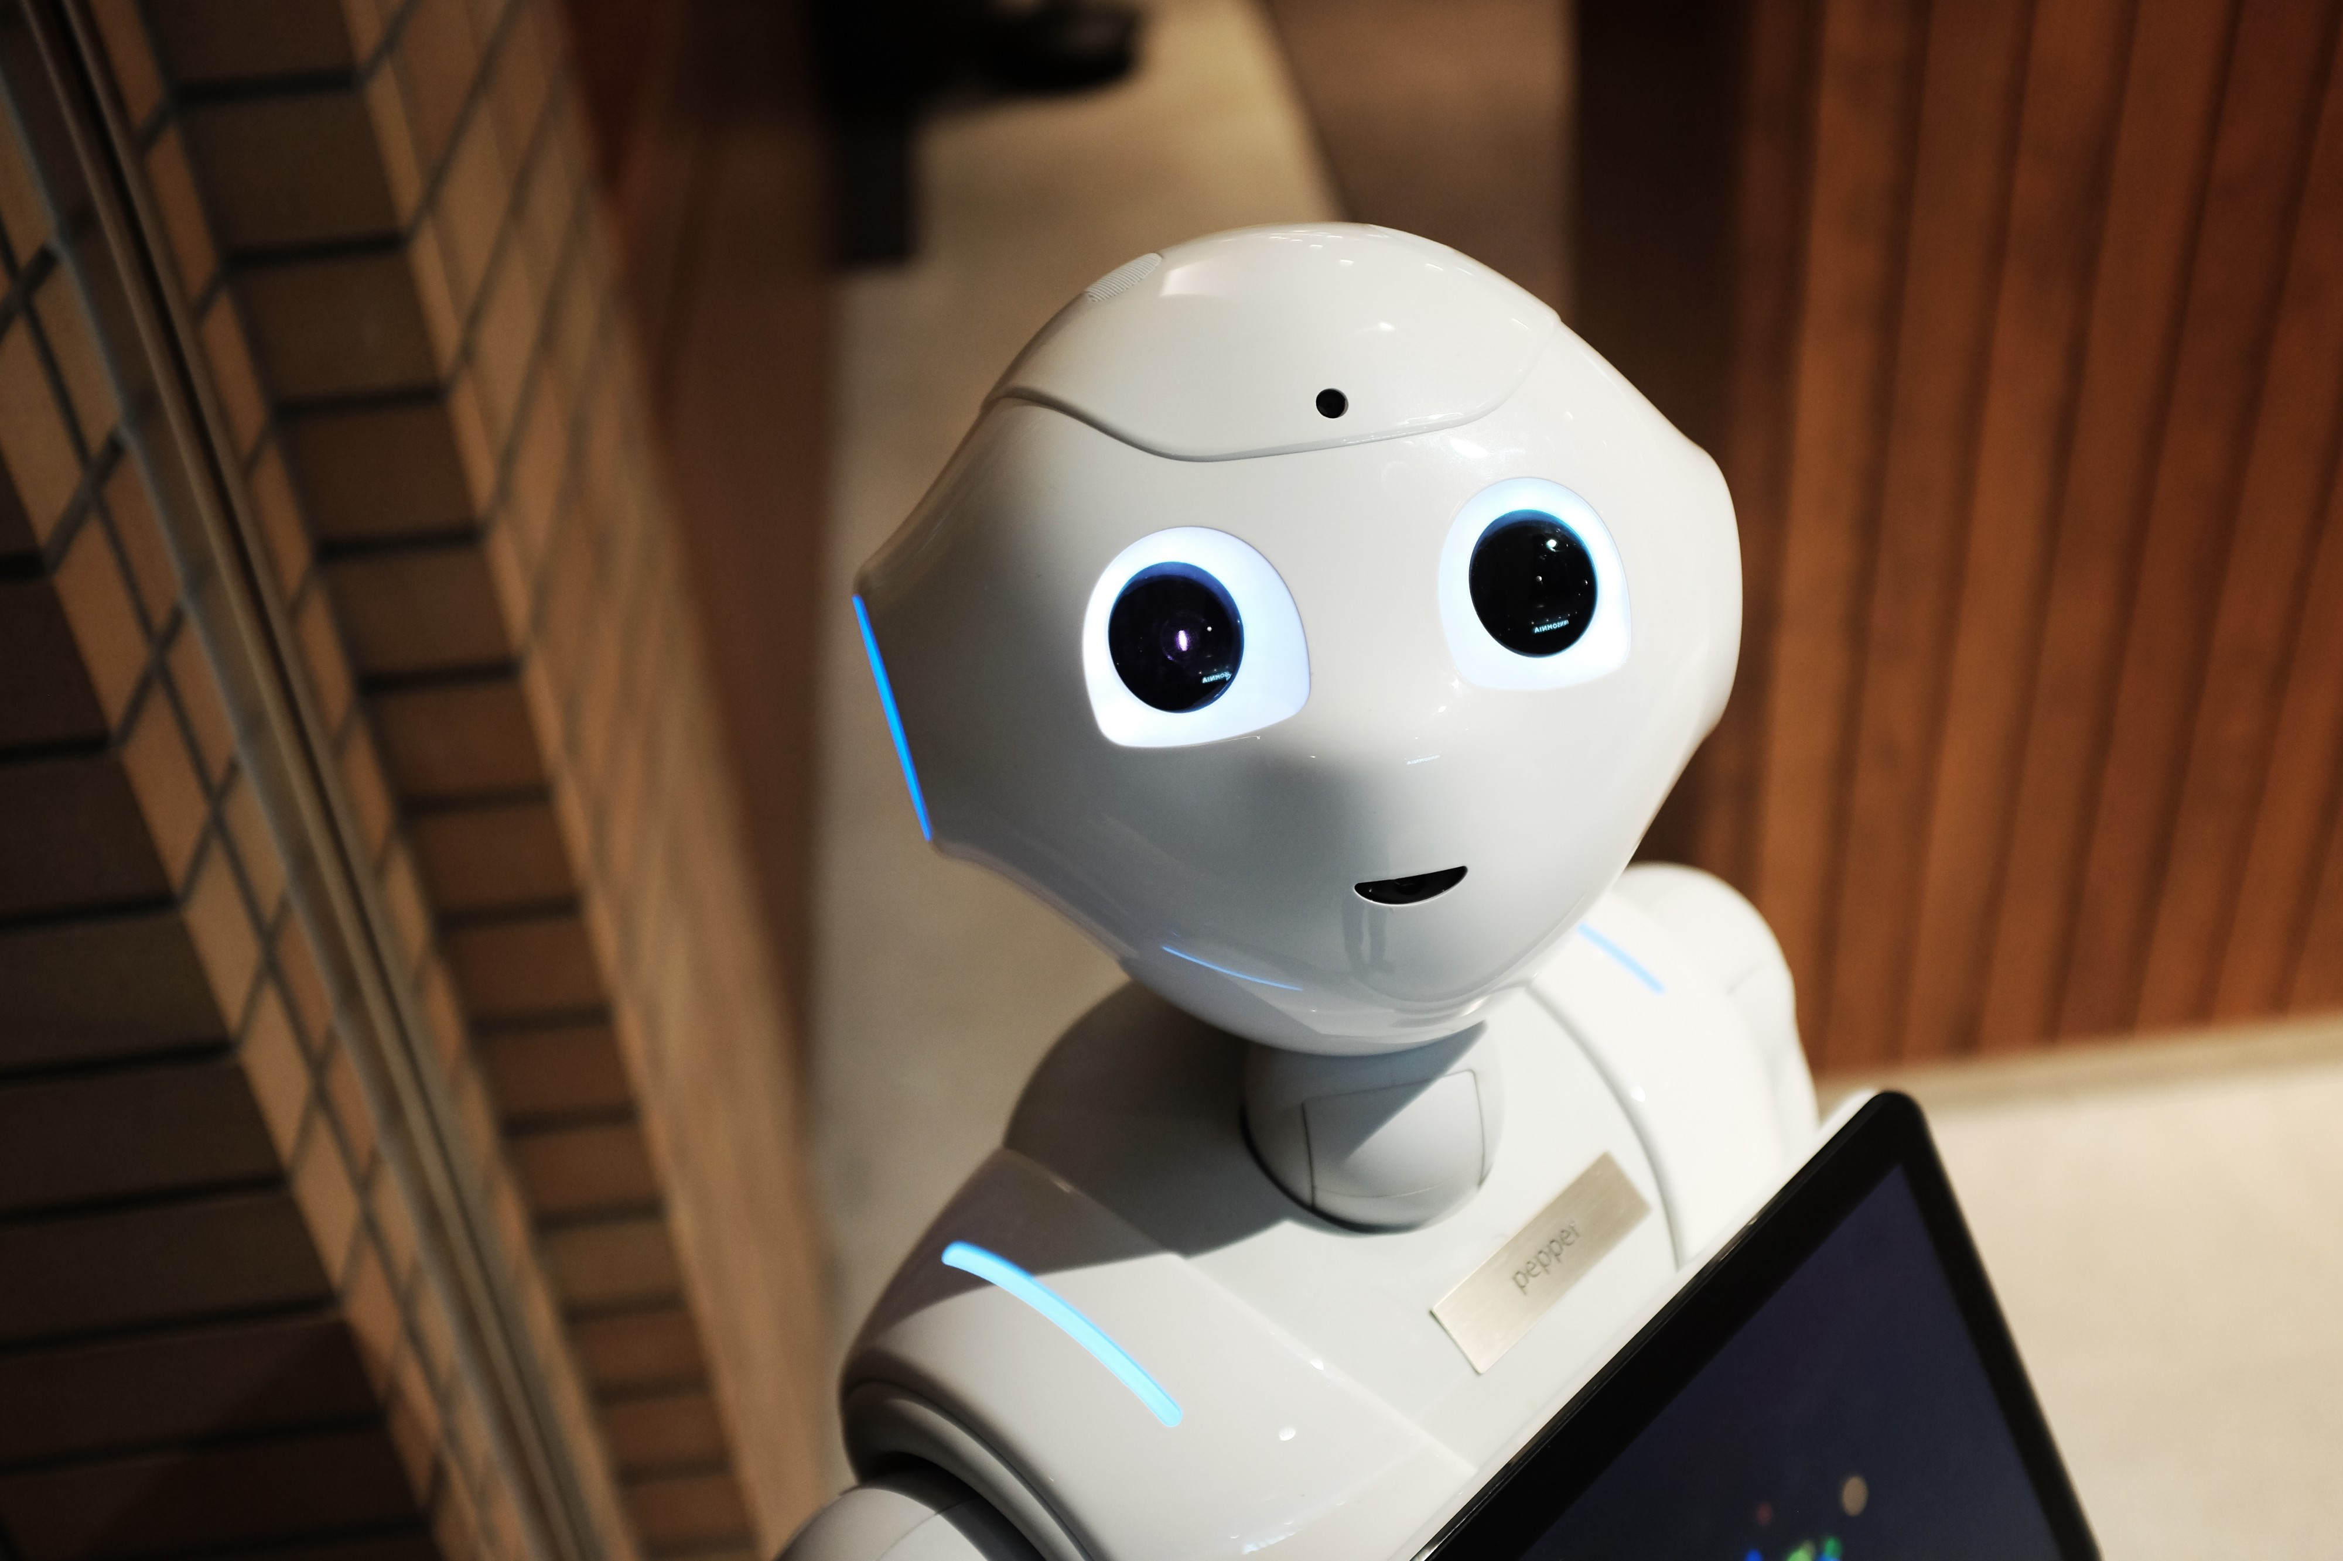
AlphaZero

Slide 5
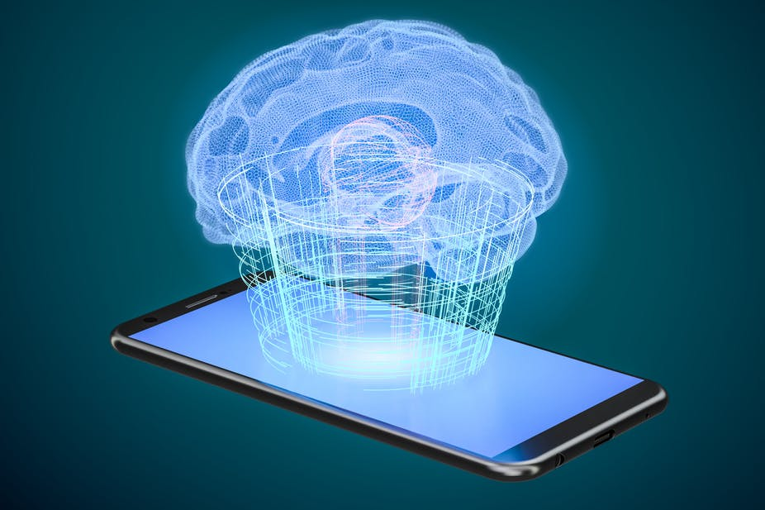
Question of the century!
Can a machine become Conscious?

Slide 6
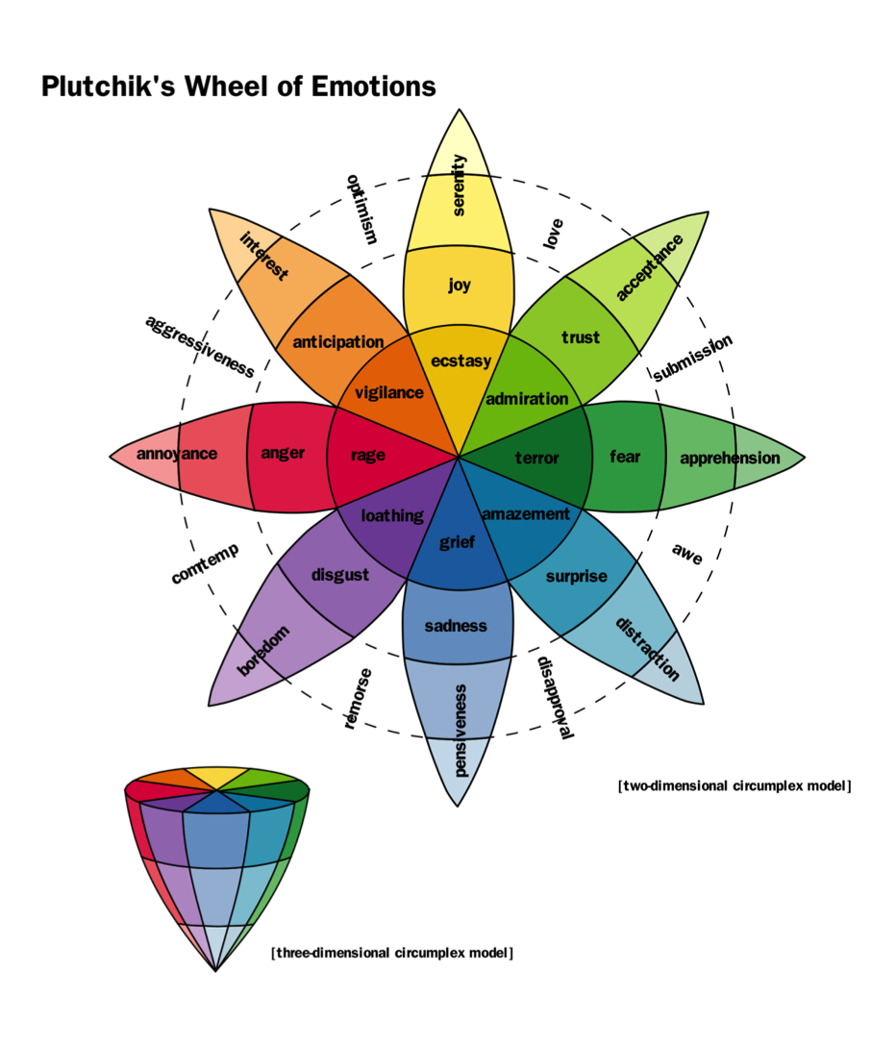

Slide 7
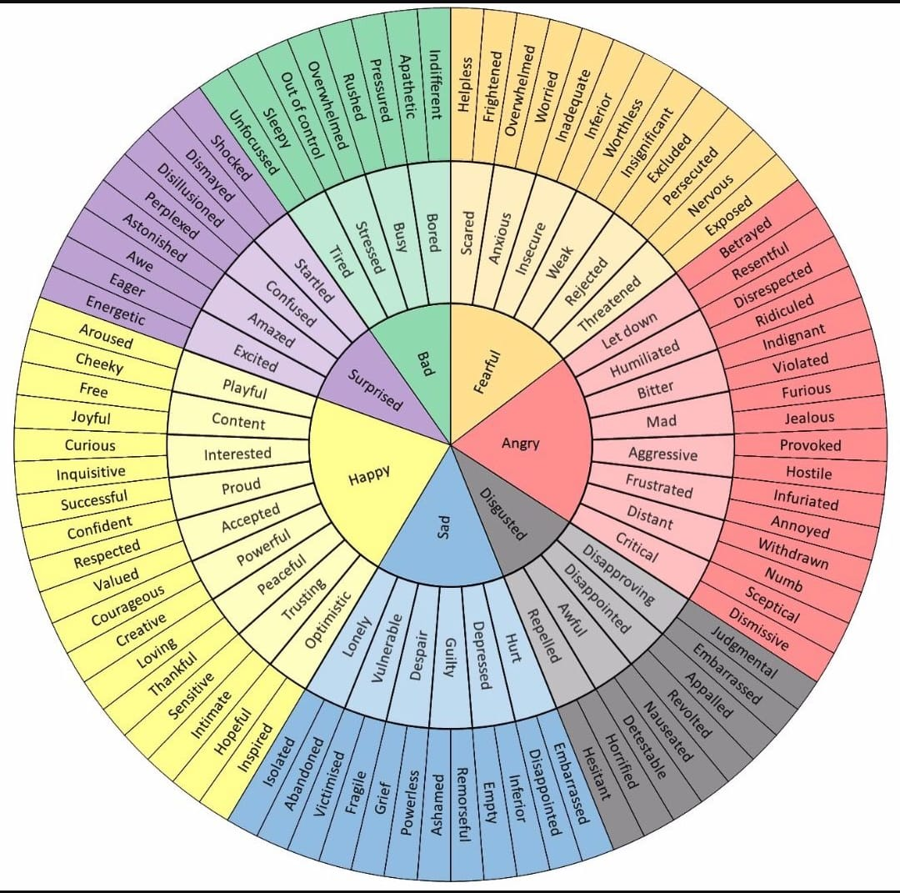

Slide 8
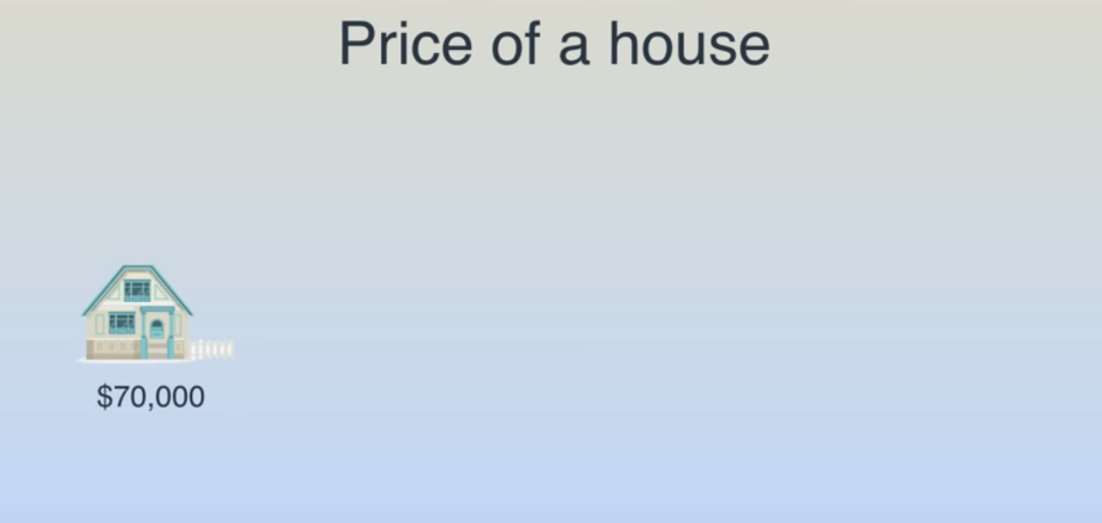

Slide 9
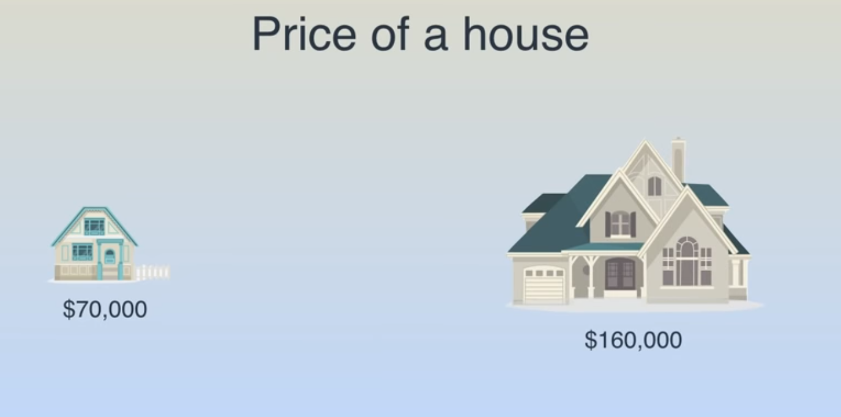

Slide 10
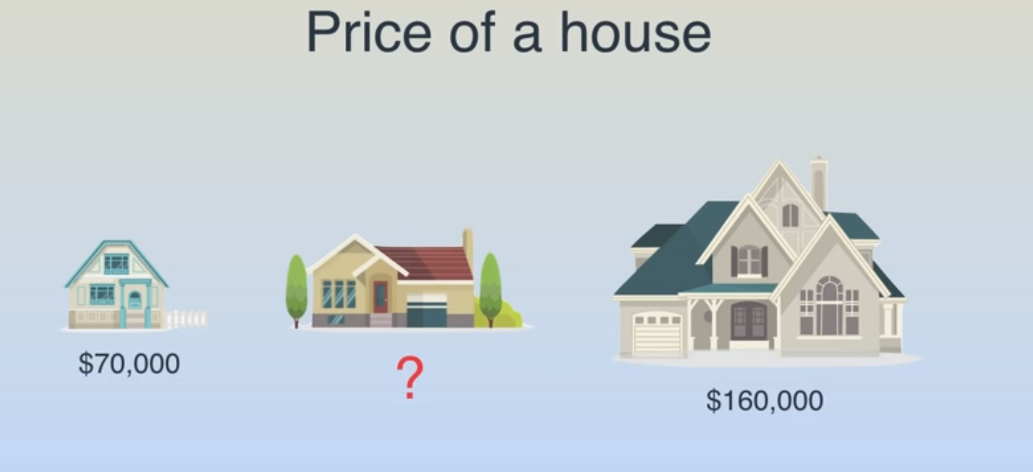

Slide 11
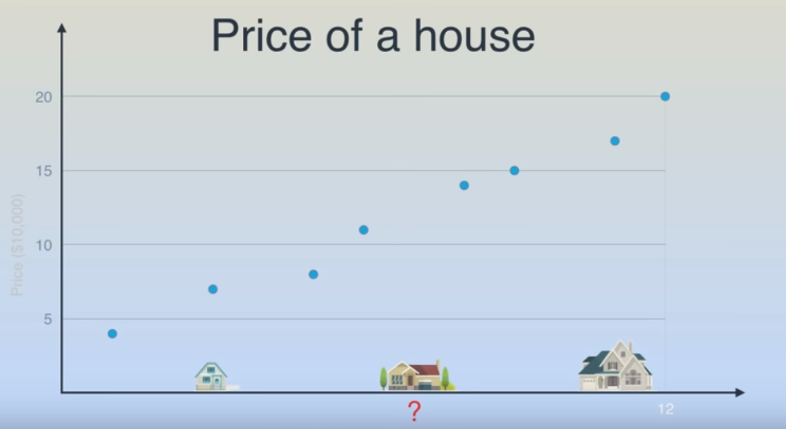

Slide 12
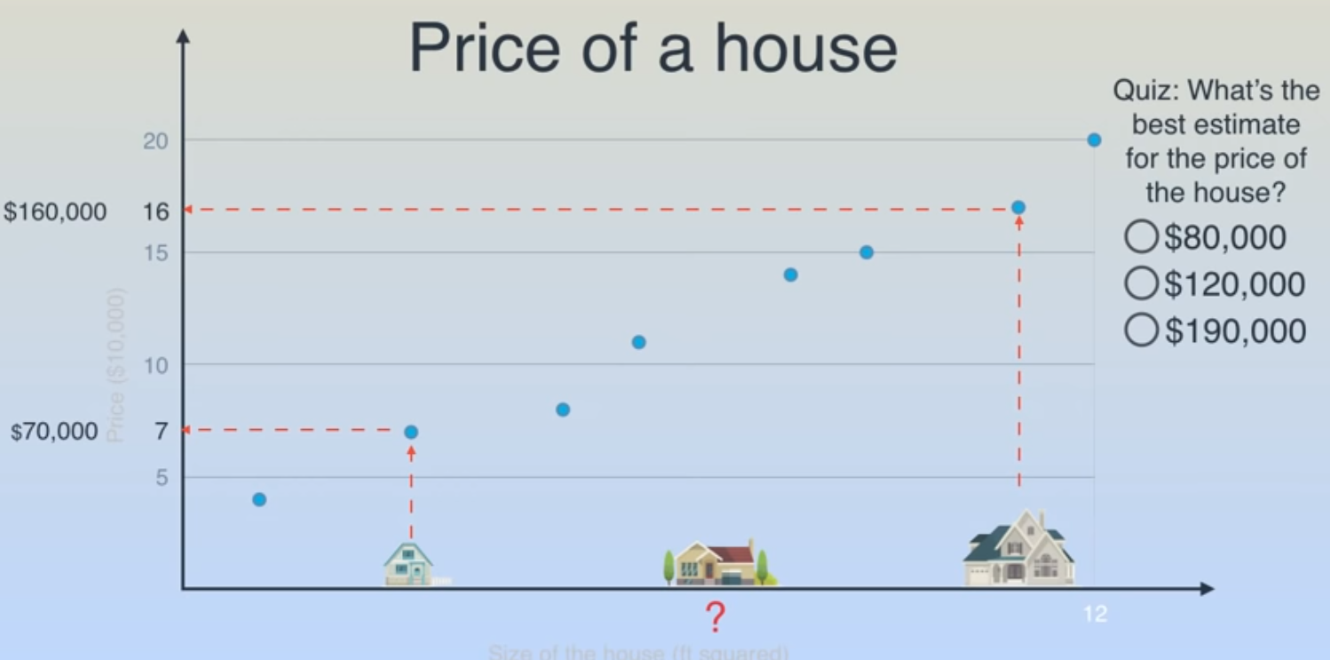

Slide 13
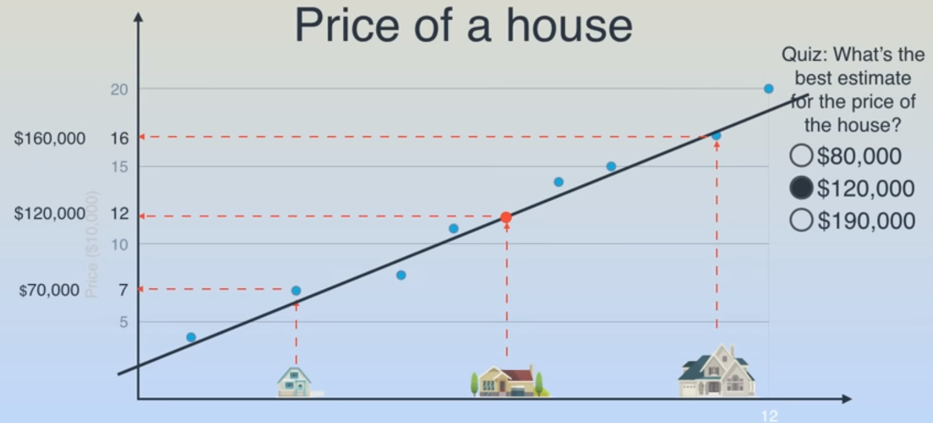

Slide 14
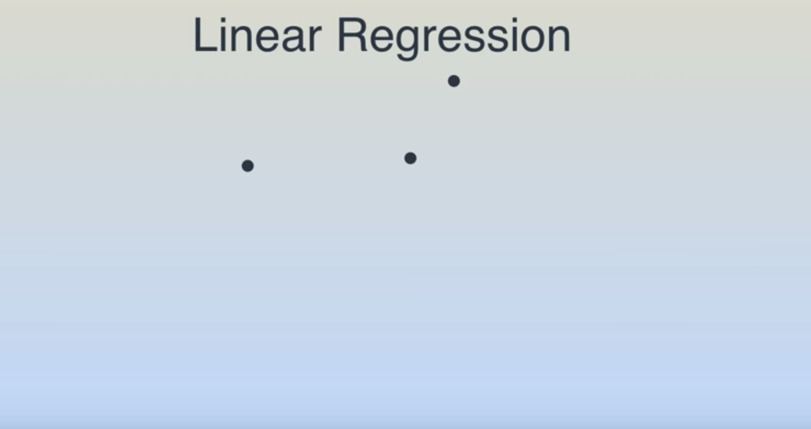

Slide 15
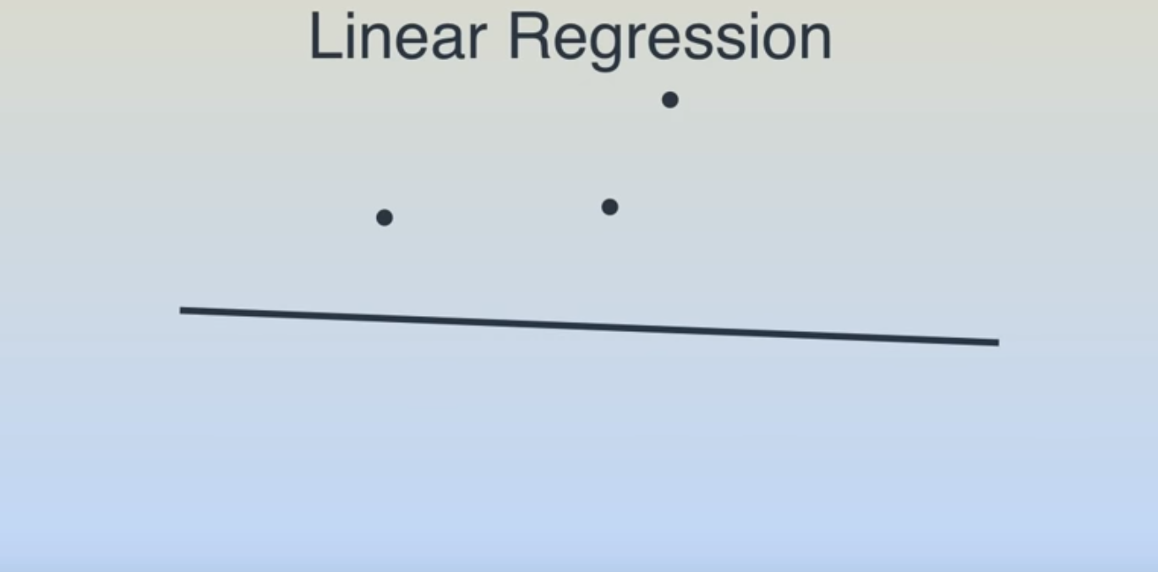

Slide 16
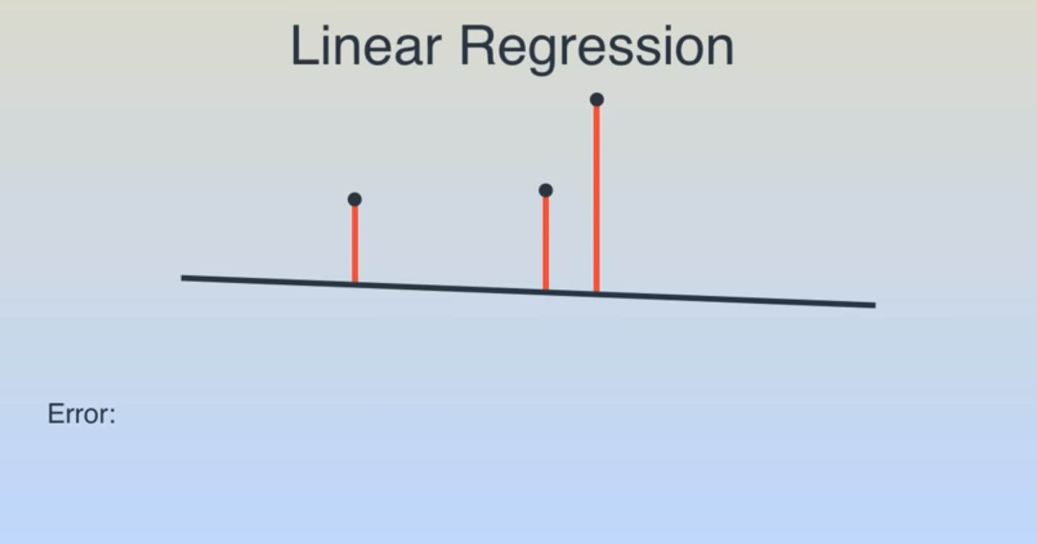

Slide 17
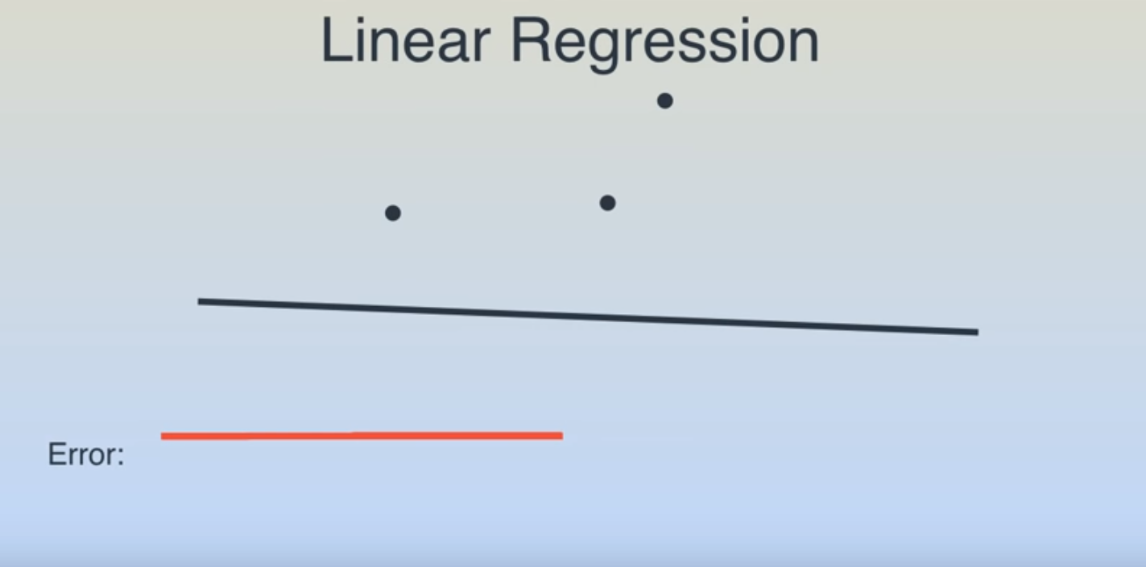

Slide 18
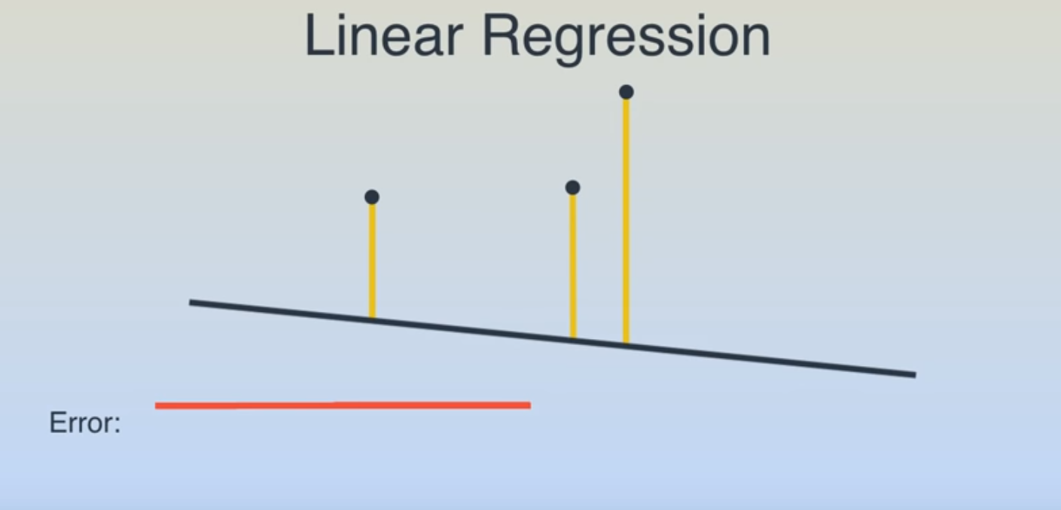

Slide 19
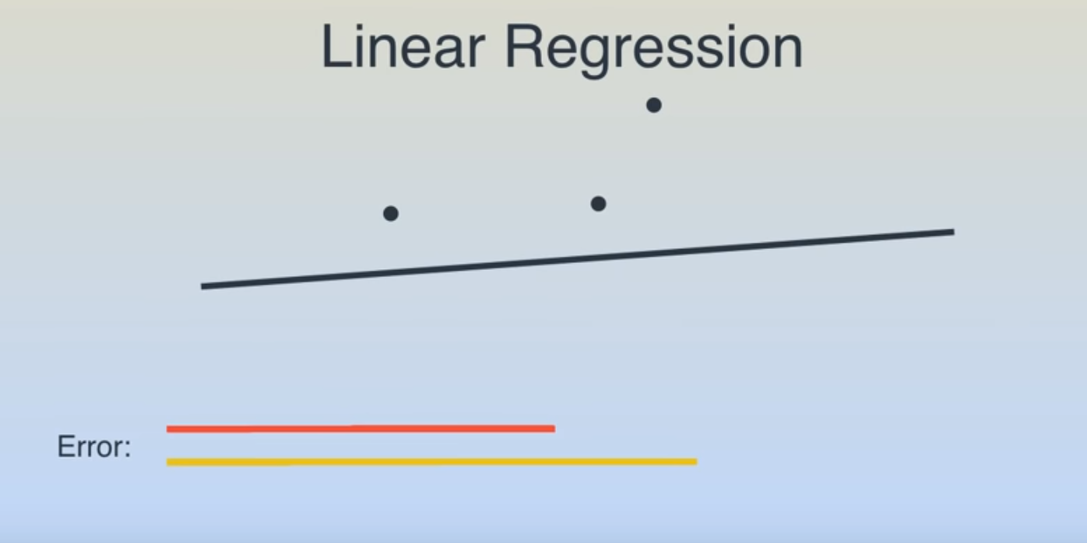

Slide 20
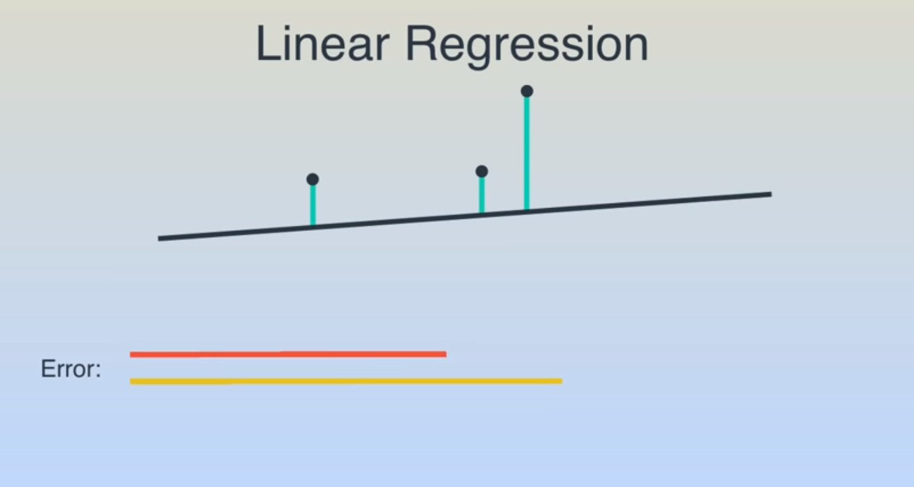

Slide 21
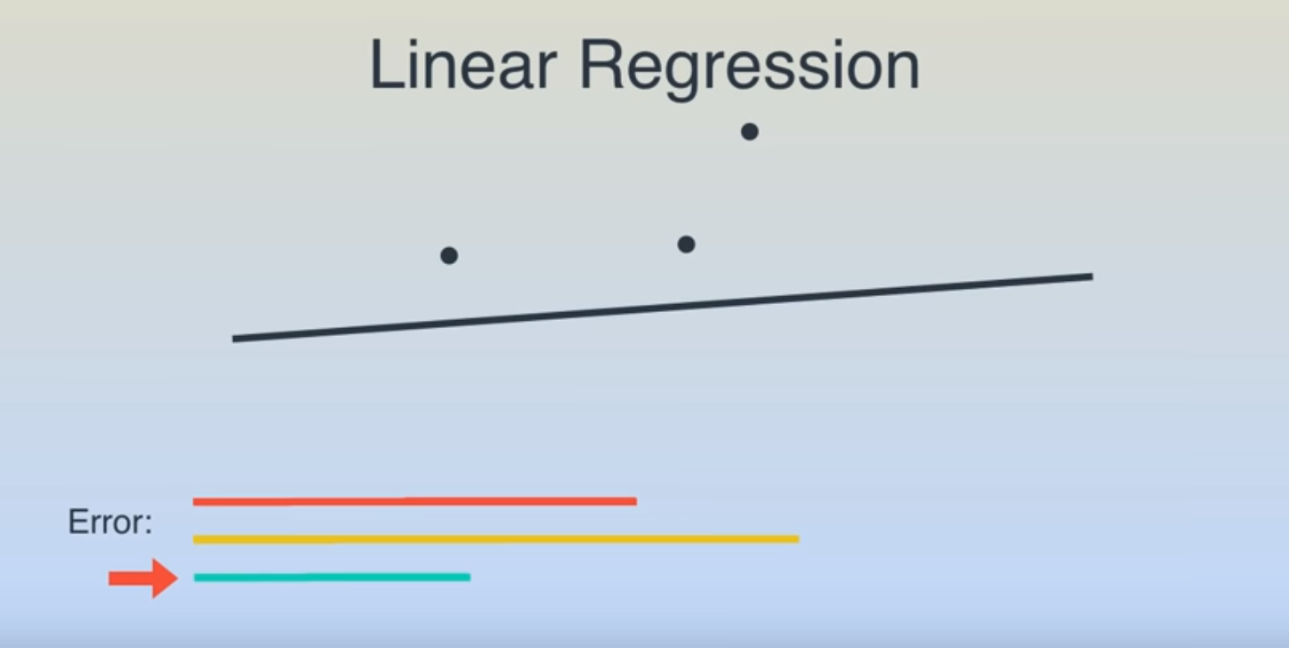

Slide 22
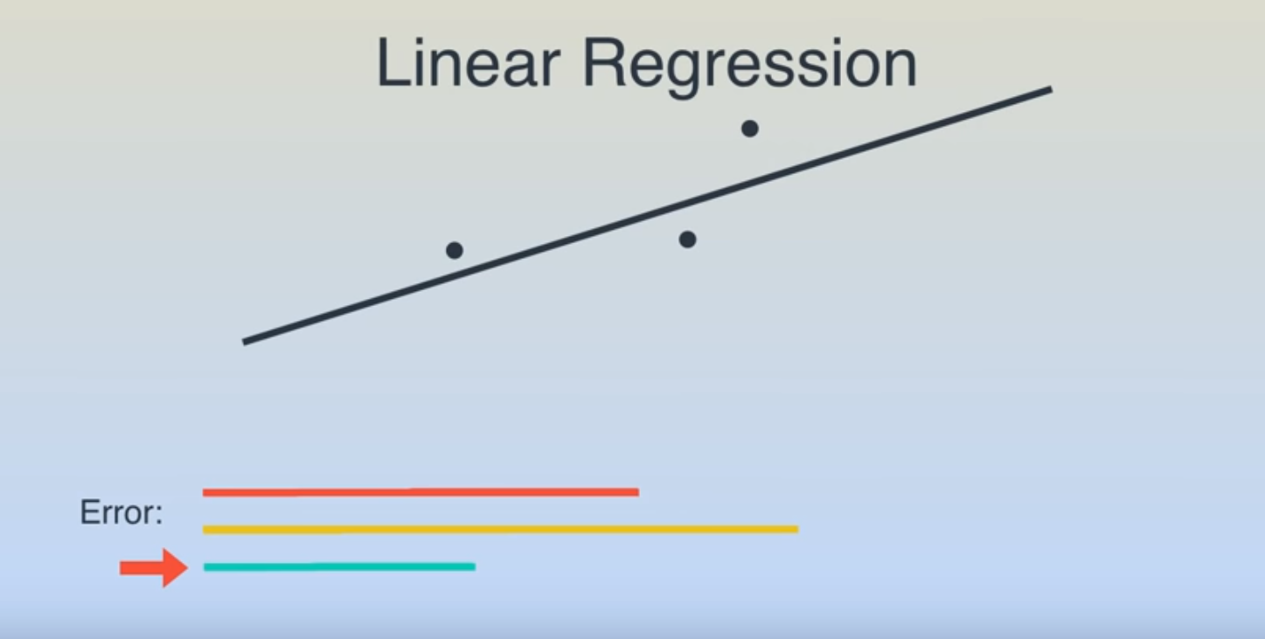

Slide 23
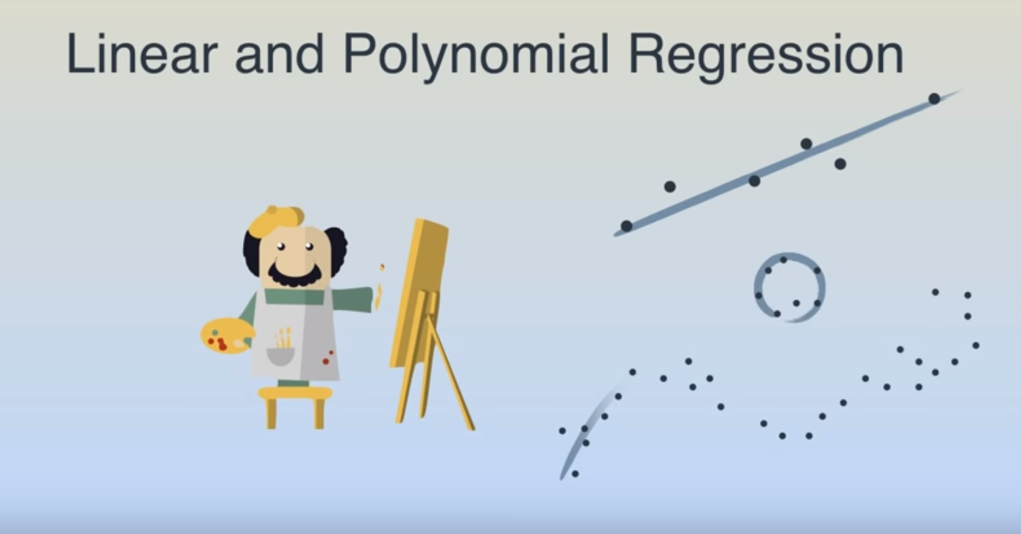

Slide 24
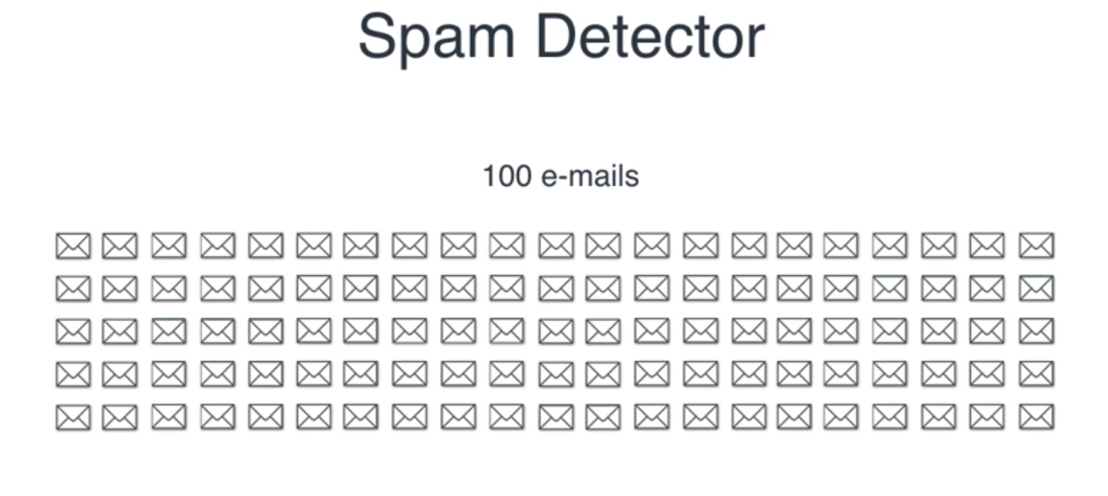

Slide 25
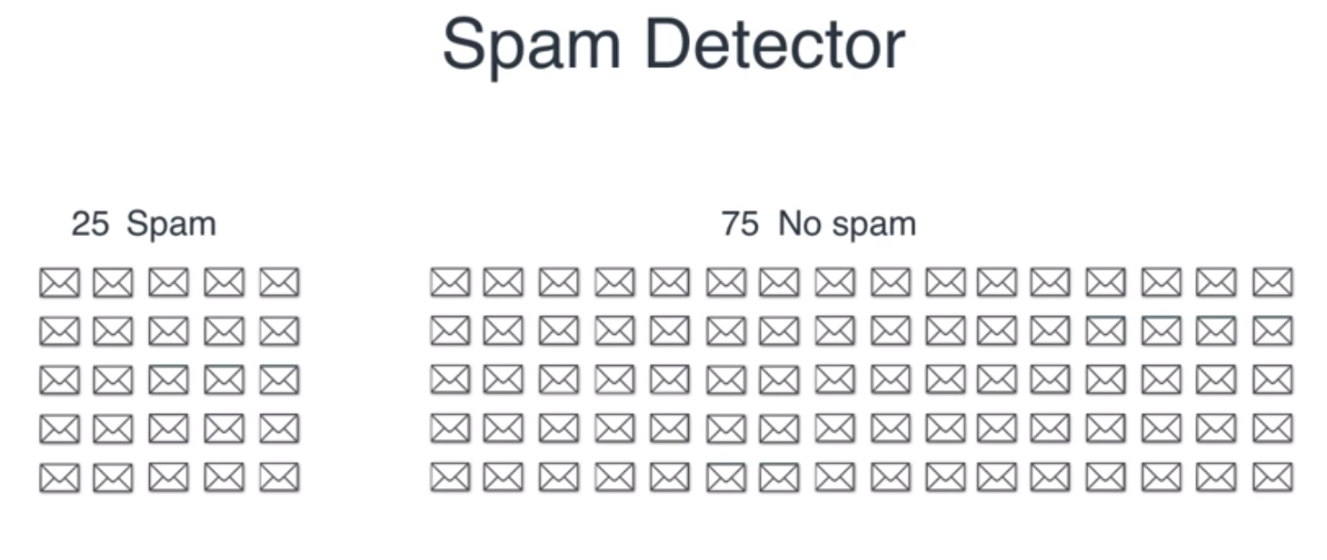

Slide 26
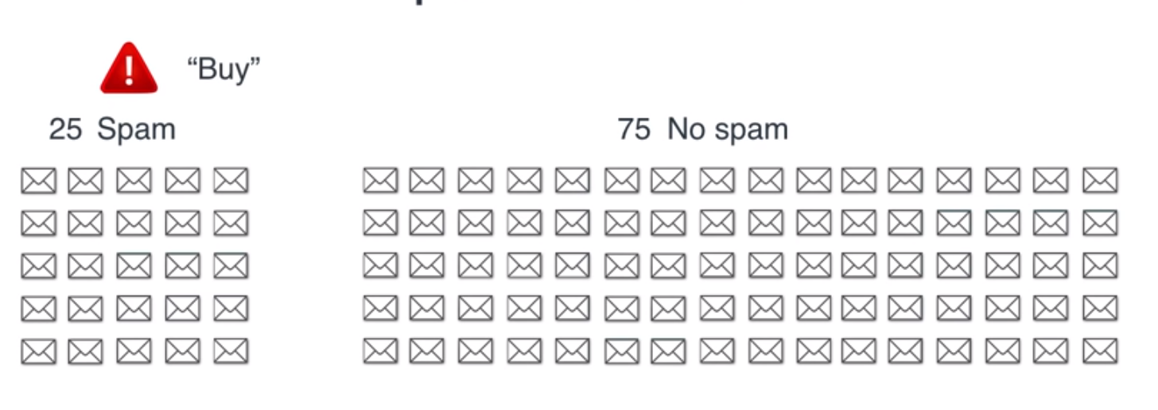

Slide 27
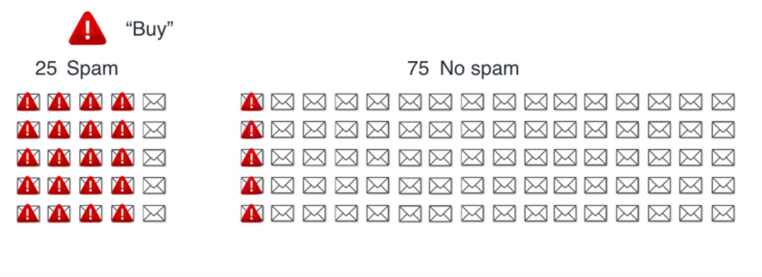

Slide 28
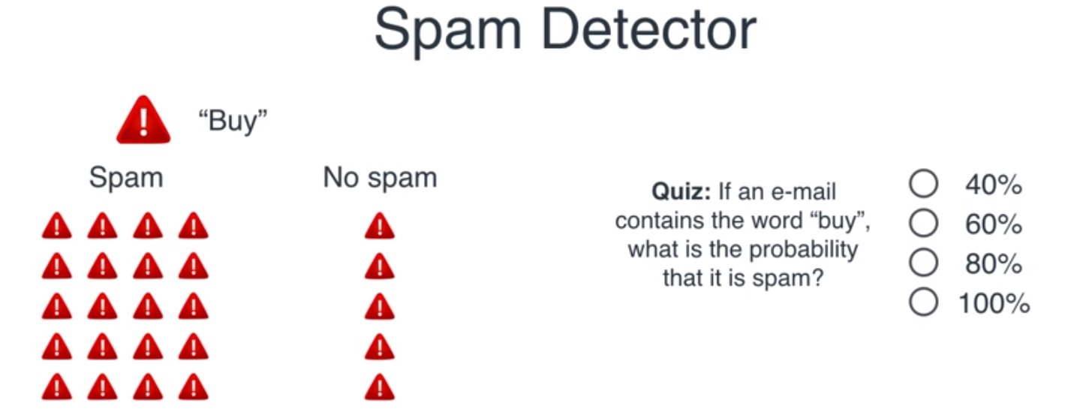

Slide 29
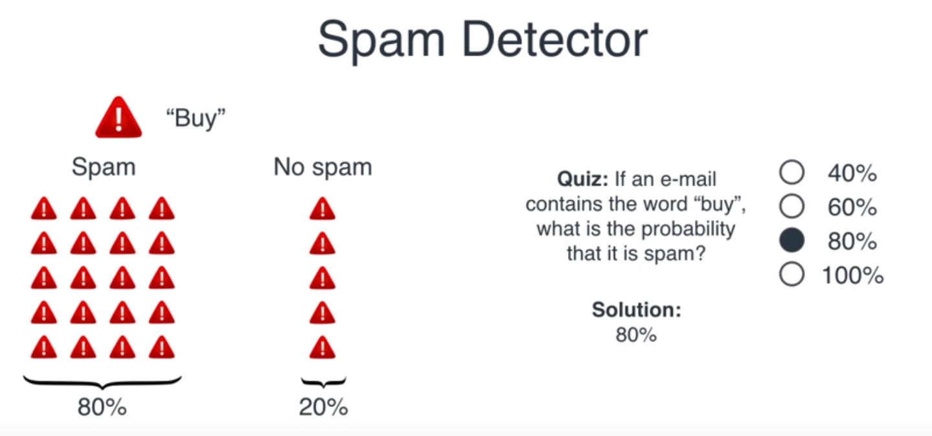

Slide 30
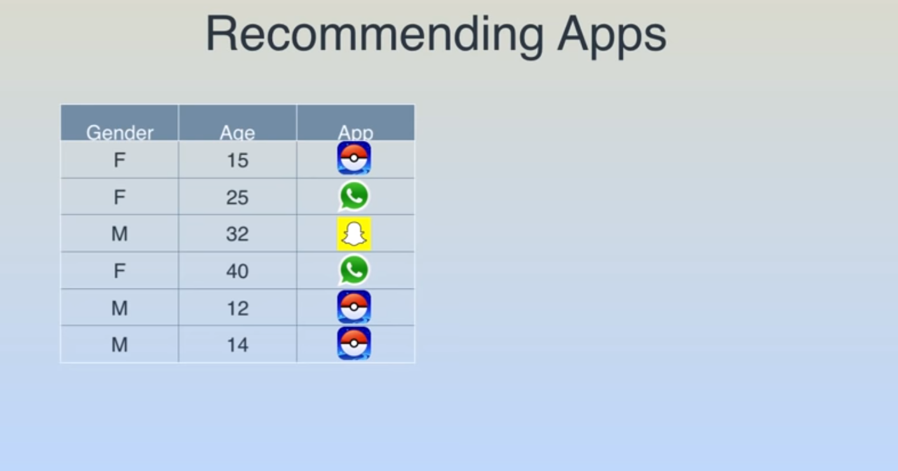

Slide 31
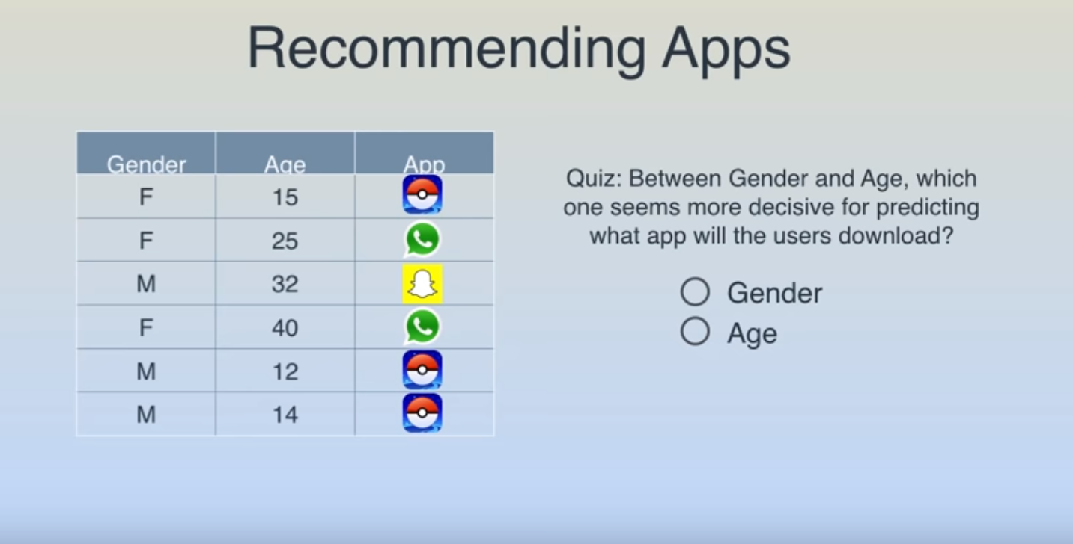

Slide 32
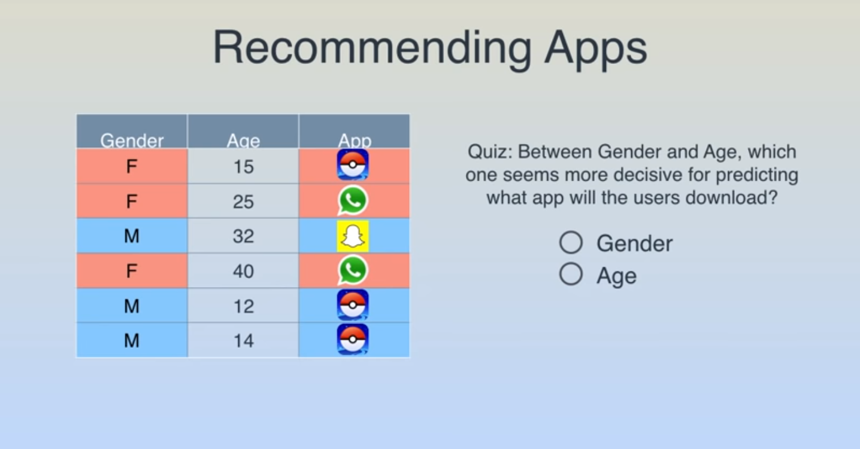

Slide 33
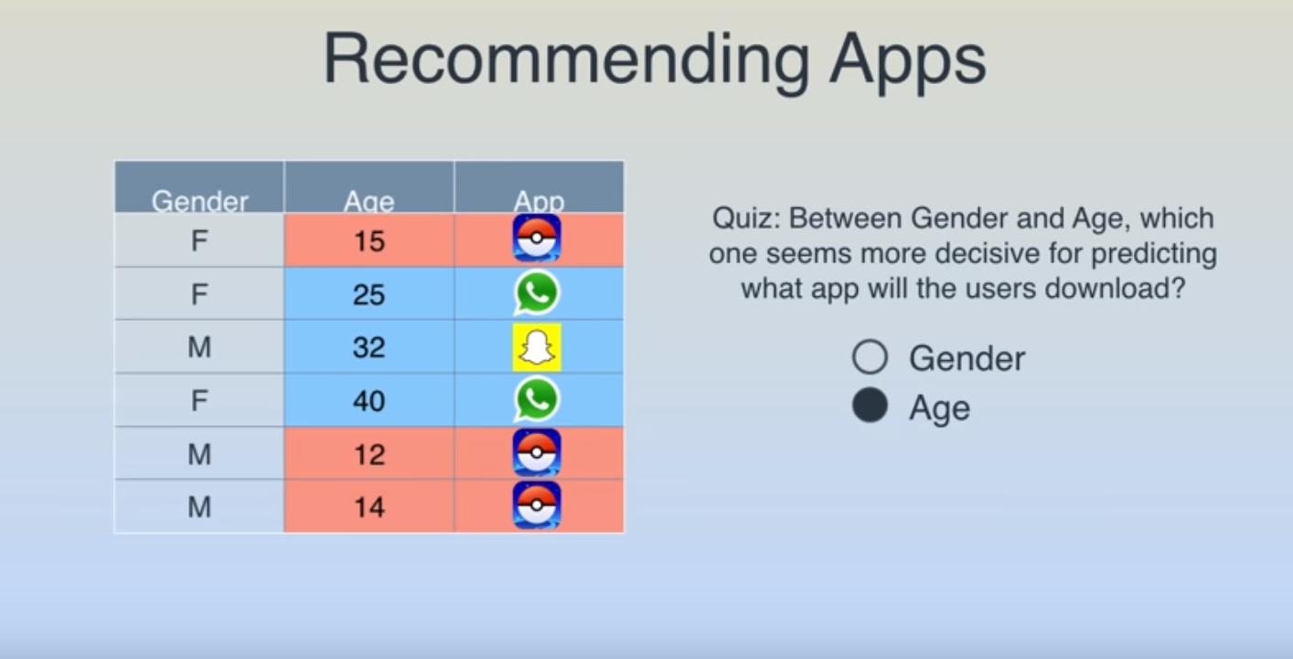

Slide 34
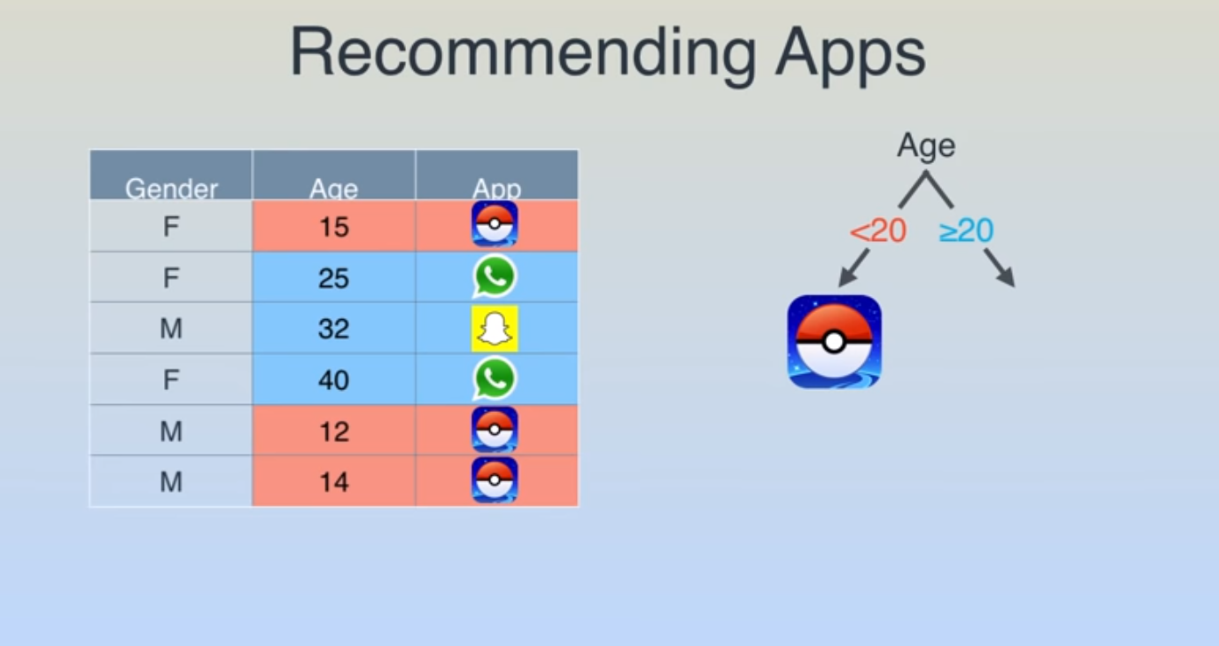

Slide 35
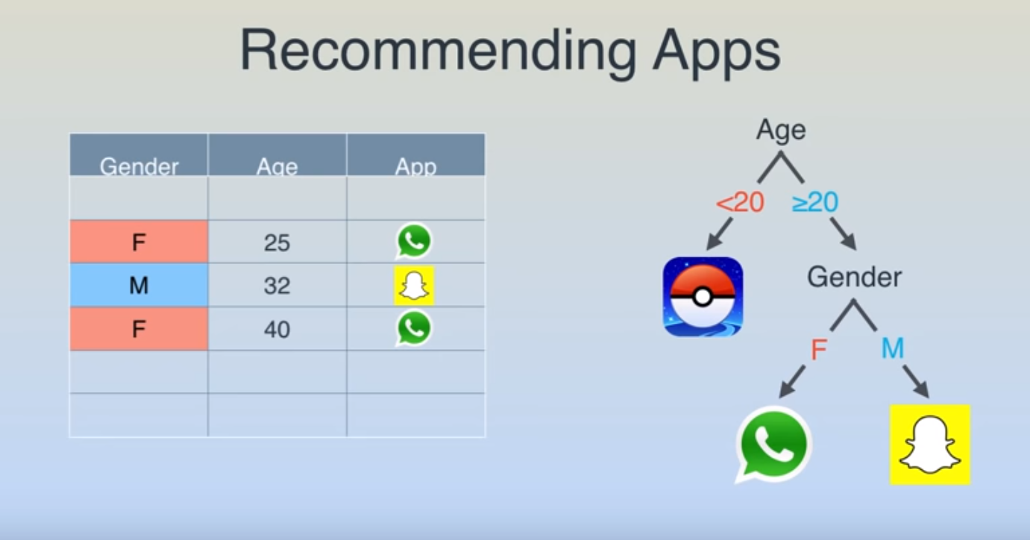

Slide 36
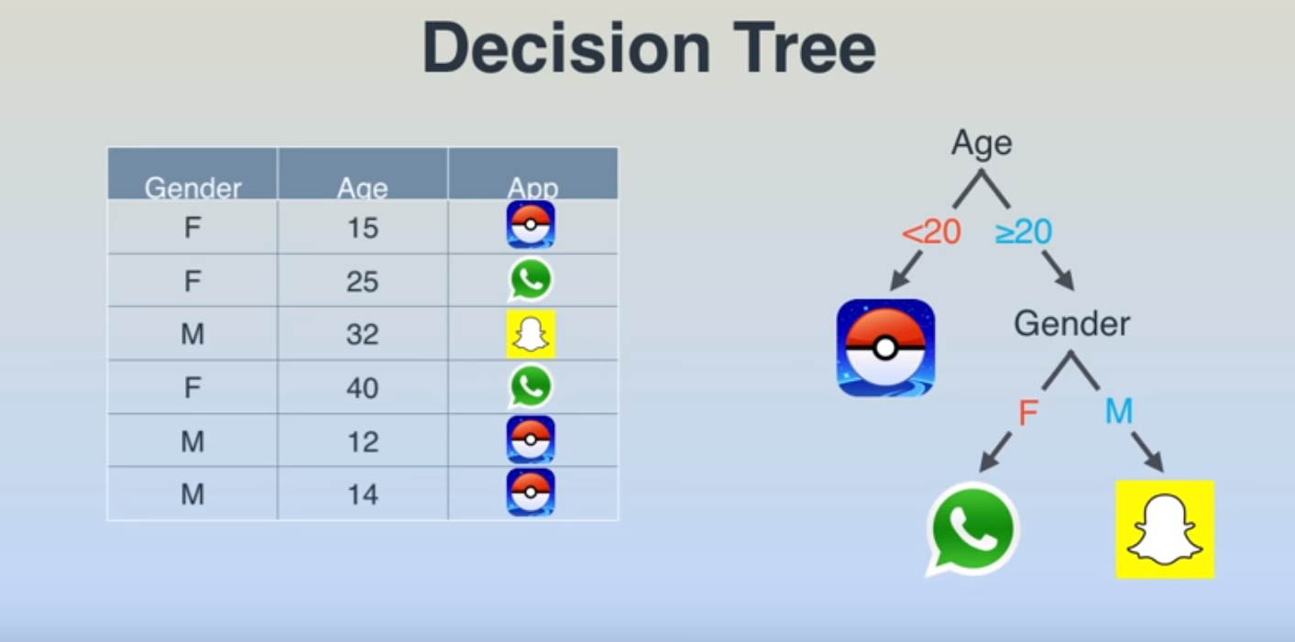

Slide 37
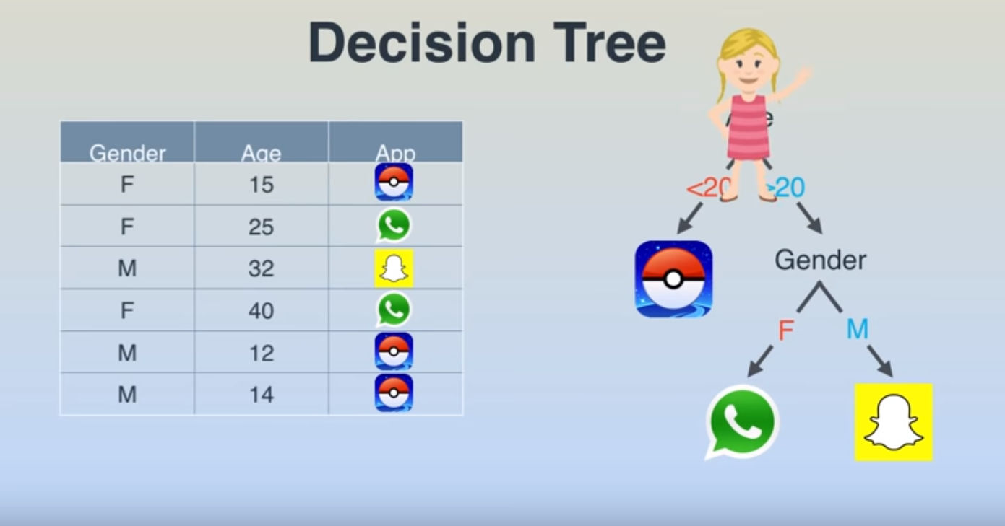

Slide 38
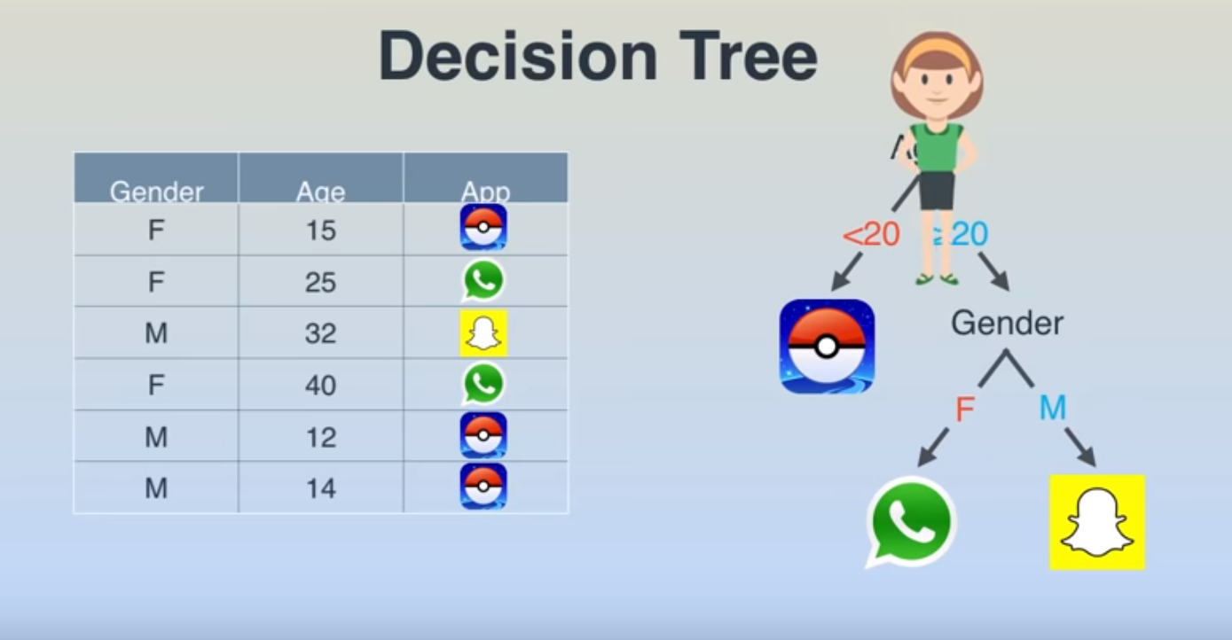

Slide 39
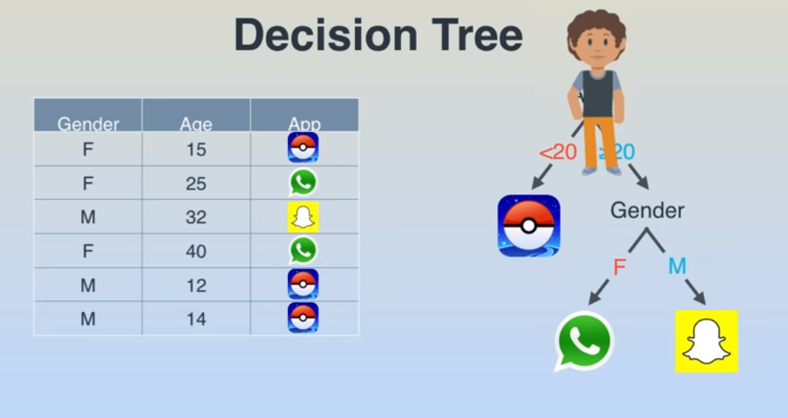

Slide 40


Slide 41
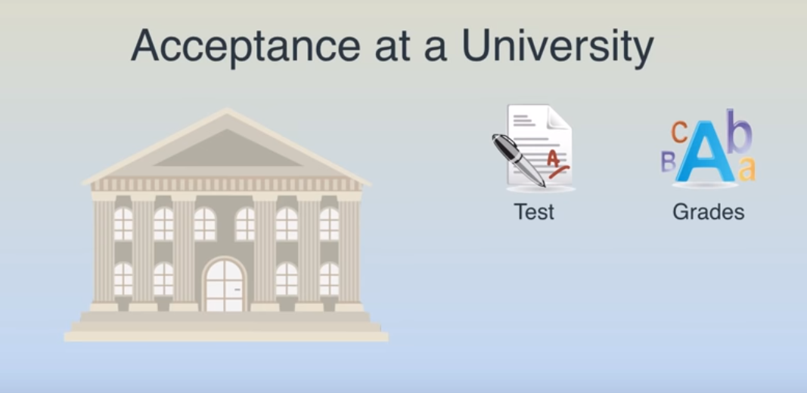

Slide 42
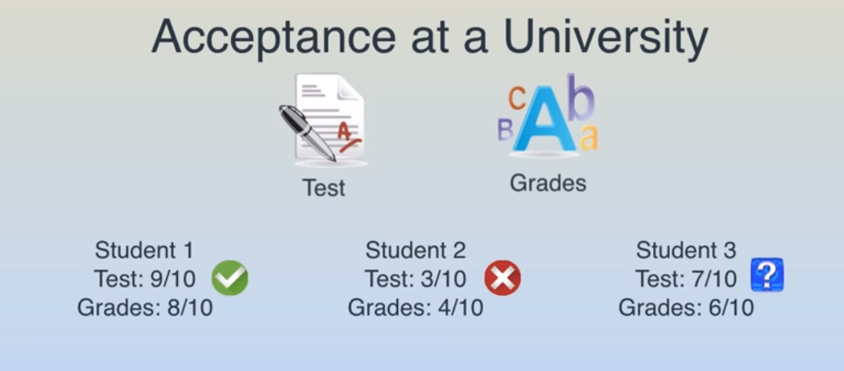

Slide 43
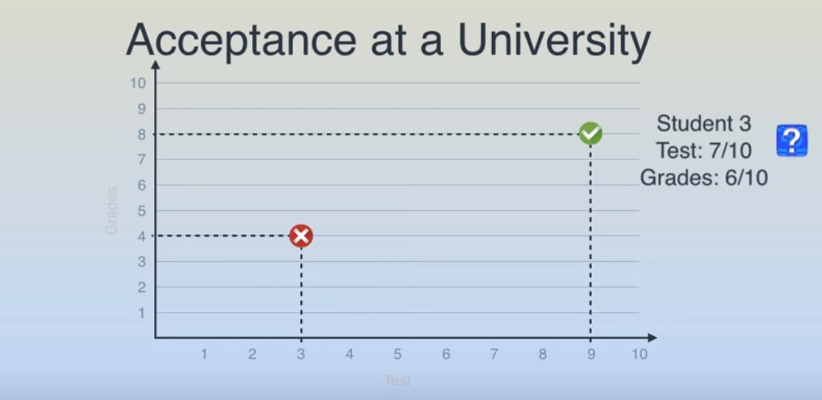

Slide 44
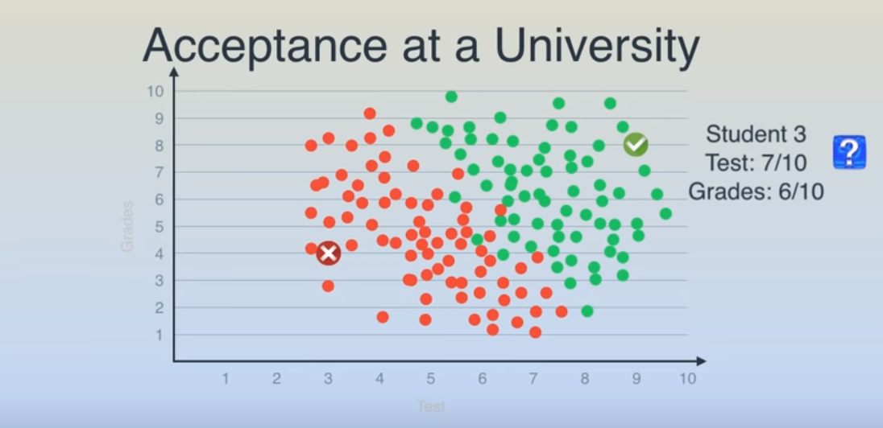

Slide 45
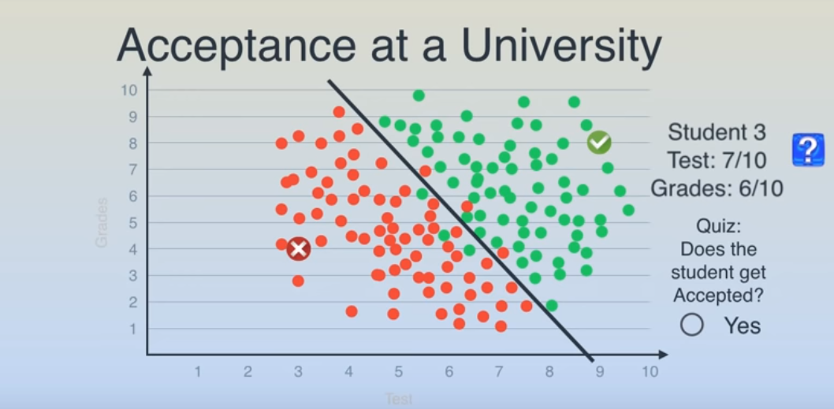

Slide 46
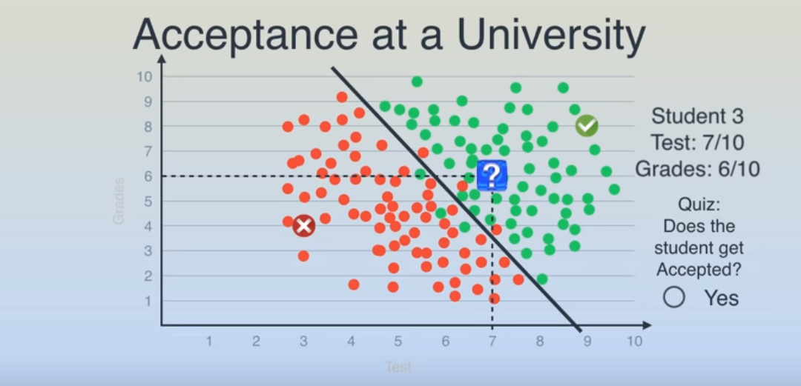

Slide 47
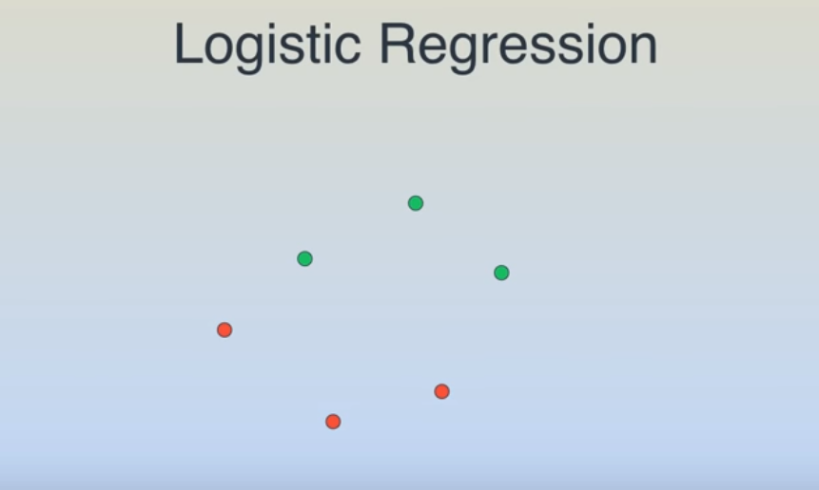

Slide 48
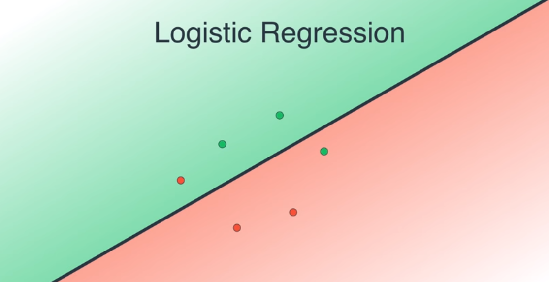

Slide 49
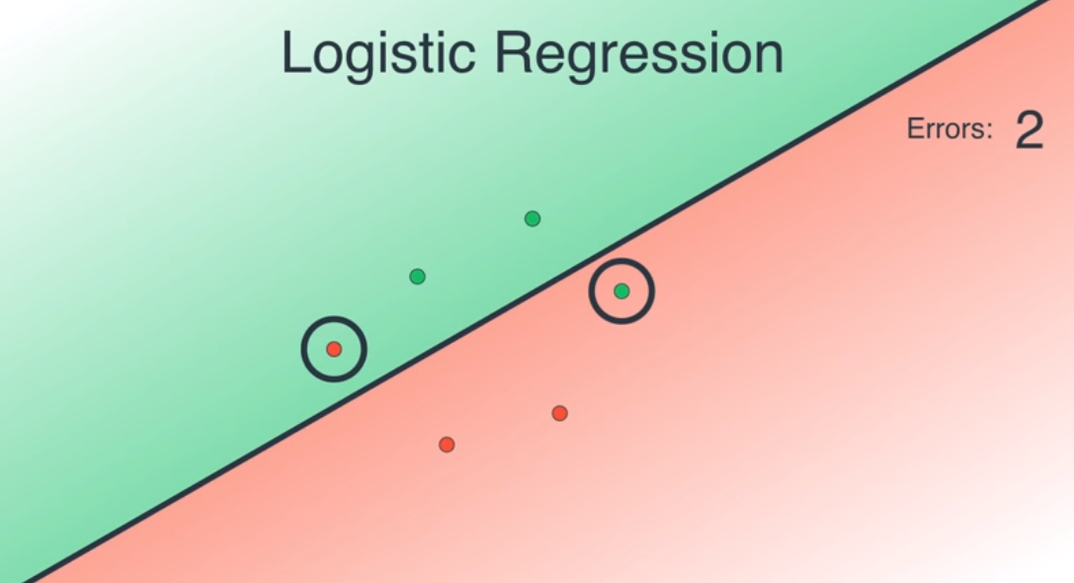

Slide 50
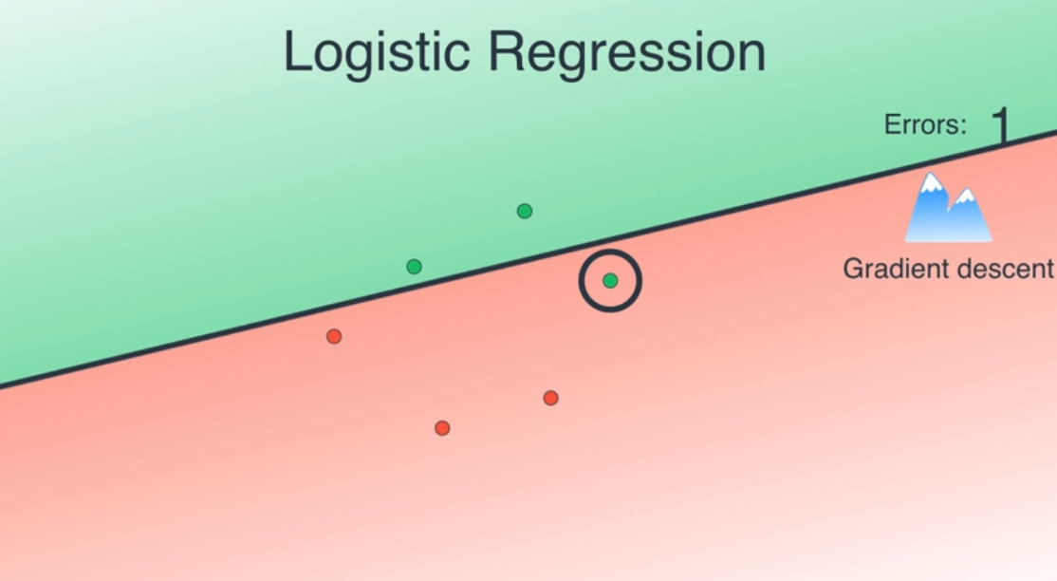

Slide 51
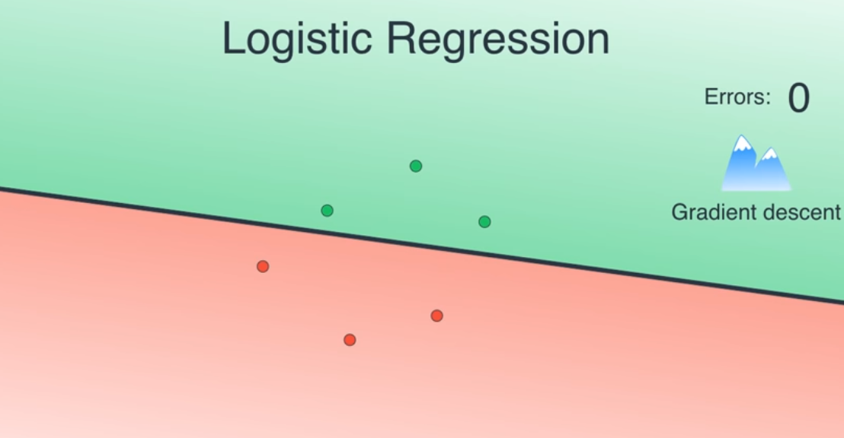

Slide 52


Slide 53


Slide 54


Slide 55


Slide 56


Slide 57


Slide 58


Slide 59


Slide 60


Slide 61


Slide 62


Slide 63


Slide 64


Slide 65


Slide 66


Slide 67


Slide 68


Slide 69


Slide 70


Slide 71


Slide 72


Slide 73


Did somebody say I_scream?

Slide 74
Did somebody say I_scream?

Slide 75
Did somebody say I_scream?

Slide 76
Did somebody say I_scream?

Slide 77
Did somebody say I_scream?

Slide 78
Did somebody say I_scream?

Slide 79
Did somebody say I_scream?

Slide 80
Did somebody say I_scream?

Slide 81
Did somebody say I_scream?
Sam
Shaun
Robin
Sandy
Robbie
Rob
Ronnie
Dan
Danna
Dane
Distance
Sandy
Shaun
Sam
Dan
Dane
Rob
Robin
Ronnie
Danna
Robbie

Slide 82
Did somebody say I_scream?
Sam
Shaun
Robin
Sandy
Robbie
Rob
Ronnie
Dan
Danna
Dane
Distance
Sandy
Shaun
Sam
Dan
Dane
Rob
Robin
Ronnie
Danna
Robbie

Slide 83
Did somebody say I_scream?
Sam
Shaun
Robin
Sandy
Robbie
Rob
Ronnie
Dan
Danna
Dane
Distance
Sandy
Shaun
Sam
Dan
Dane
Rob
Robin
Ronnie
Danna
Robbie

Slide 84
Did somebody say I_scream?
Sam
Shaun
Robin
Sandy
Robbie
Rob
Ronnie
Dan
Danna
Dane
Distance
Sandy
Shaun
Sam
Dan
Dane
Rob
Robin
Ronnie
Danna
Robbie

Slide 85
Did somebody say I_scream?
Sam
Shaun
Robin
Sandy
Robbie
Rob
Ronnie
Dan
Danna
Dane
Distance
Sandy
Shaun
Sam
Dan
Dane
Rob
Robin
Ronnie
Danna
Robbie

Slide 86
Did somebody say I_scream?
Sam
Shaun
Robin
Sandy
Robbie
Rob
Ronnie
Dan
Danna
Dane
Distance
Sandy
Shaun
Sam
Dan
Dane
Rob
Robin
Ronnie
Danna
Robbie

Slide 87
Did somebody say I_scream?
Sam
Shaun
Robin
Sandy
Robbie
Rob
Ronnie
Dan
Danna
Dane
Distance
Sandy
Shaun
Sam
Dan
Dane
Rob
Robin
Ronnie
Danna
Robbie

Slide 88
Did somebody say I_scream?
Sam
Shaun
Robin
Sandy
Robbie
Rob
Ronnie
Dan
Danna
Dane
Distance
Sandy
Shaun
Sam
Dan
Dane
Rob
Robin
Ronnie
Danna
Robbie

Slide 89
Did somebody say I_scream?
Sam
Shaun
Robin
Sandy
Robbie
Rob
Ronnie
Dan
Danna
Dane
Distance
Sandy
Shaun
Sam
Dan
Dane
Rob
Robin
Ronnie
Danna
Robbie

Slide 90
Did somebody say I_scream?
Sam
Shaun
Robin
Sandy
Robbie
Rob
Ronnie
Dan
Danna
Dane
Distance
Sandy
Shaun
Sam
Dan
Dane
Rob
Robin
Ronnie
Danna
Robbie

Slide 91
Did somebody say I_scream?
Sam
Shaun
Robin
Sandy
Robbie
Rob
Ronnie
Dan
Danna
Dane
Distance
Sandy
Shaun
Sam
Dan
Dane
Rob
Robin
Ronnie
Danna
Robbie

Slide 92
Did somebody say I_scream?
Sam
Shaun
Robin
Sandy
Robbie
Rob
Ronnie
Dan
Danna
Dane
Distance
Sandy
Shaun
Sam
Dan
Dane
Rob
Robin
Ronnie
Danna
Robbie

Slide 93
Did somebody say I_scream?
Sam
Shaun
Robin
Sandy
Robbie
Rob
Ronnie
Dan
Danna
Dane
Distance
Sandy
Shaun
Sam
Dan
Dane
Rob
Robin
Ronnie
Danna
Robbie

Slide 94
Did somebody say I_scream?
Sam
Shaun
Robin
Sandy
Robbie
Rob
Ronnie
Dan
Danna
Dane
Distance
Sandy
Shaun
Sam
Dan
Dane
Rob
Robin
Ronnie
Danna
Robbie

Slide 95
Did somebody say I_scream?
Sam
Shaun
Robin
Sandy
Robbie
Rob
Ronnie
Dan
Danna
Dane
Distance
Sandy
Shaun
Sam
Dan
Dane
Rob
Robin
Ronnie
Danna
Robbie

Slide 96
Did somebody say I_scream?
Sam
Shaun
Robin
Sandy
Robbie
Rob
Ronnie
Dan
Danna
Dane
Distance
Sandy
Shaun
Sam
Dan
Dane
Rob
Robin
Ronnie
Danna
Robbie

Slide 97
Did somebody say I_scream?
Sam
Shaun
Robin
Sandy
Robbie
Rob
Ronnie
Dan
Danna
Dane
Distance
Sandy
Shaun
Sam
Dan
Dane
Rob
Robin
Ronnie
Danna
Robbie

Slide 98
Types of Machine learning
Supervised
Unsupervised

Slide 99


Slide 100

What’s next?
Are there more algorithms?
Which one to use?
How to compare or evaluate them?
Application on projects (Kaggle is recommended)

Slide 101

Discussion

Slide 102

Thank you!!!!!!

